Slide 1
Fundamentals of Fog and Edge Computing
BCSE313L
WINTER 2024 - 2025
Module 3 - Orchestration of Network Slices in Fog, Edge, and Clouds

Slide 2
Introduction
Digital transformation is reshaping various sectors through innovative applications such as smart cities, vehicle-to-vehicle (V2V) communication, virtual reality (VR), augmented reality (AR), and remote medical surgery.
These applications have distinct connectivity and performance requirements, presenting significant challenges for traditional network infrastructures that rely on a one-size-fits-all approach.

Slide 3
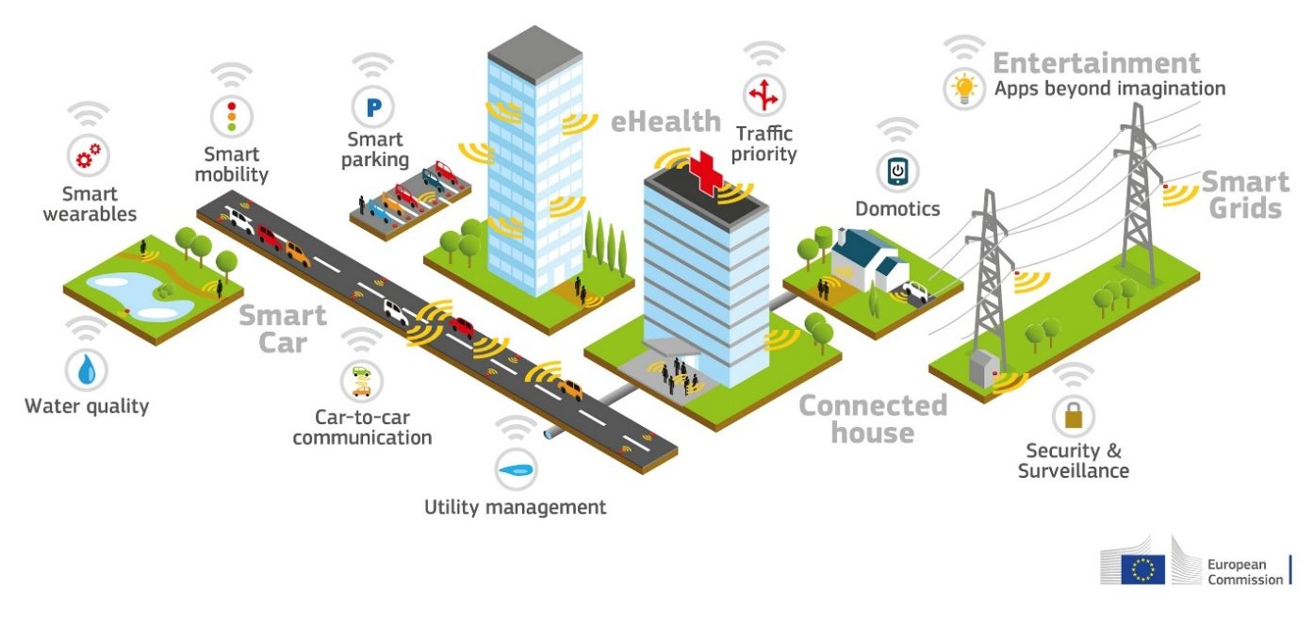
Digital Transformation Has Led Explosion in

Slide 4
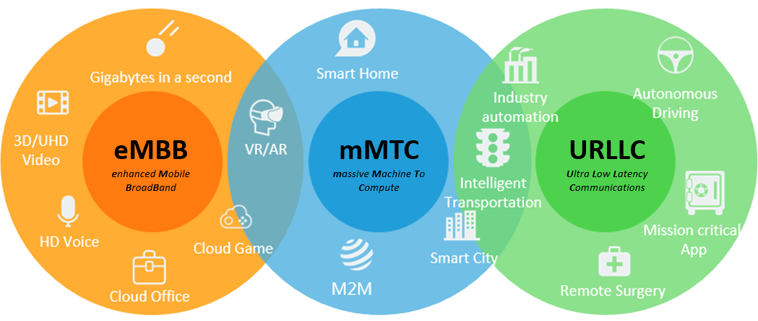
Digital Transformation Has Led Explosion in

Slide 5
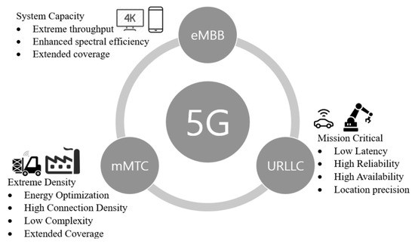
Introduction - Key Use Cases and Quality of Service Requirements

Slide 6
Introduction
The 5G infrastructure public-private partnership (5G-PPP) has categorized these applications into three main use case families:
Enhanced mobile broadband (eMBB),
Massive machine-type communications (mMTC)
Ultra-reliable low-latency communication (uRLLC)

Slide 7
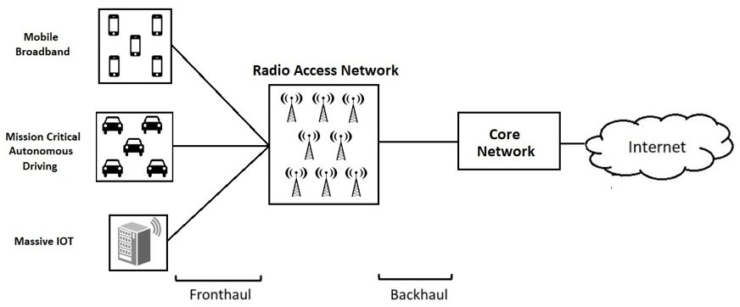
Introduction – Traditional Network Architecture Limitations
The diverse quality of service (QoS) requirements of these use cases highlight the limitations of traditional network architectures, which cannot efficiently support the varying demands of different vertical services.
Notes:
Fronthaul refers to the segment of the network that connects the radio units (such as base stations) to the centralized processing units (baseband units). This connection is crucial for transmitting data between these components, enabling the processing of signals and delivering data to end-users.
Backhaul connects the baseband unit to the core network, facilitating the transport of data from the baseband unit to its final destination within the network infrastructure.

Slide 8
Introduction – Traditional Network Architecture Limitations
Manual Configurations
Limited Scalability
Inconsistent Quality of Service (QoS)
Complexity in Management
Rigid Architecture
Vendor Dependence

Slide 9
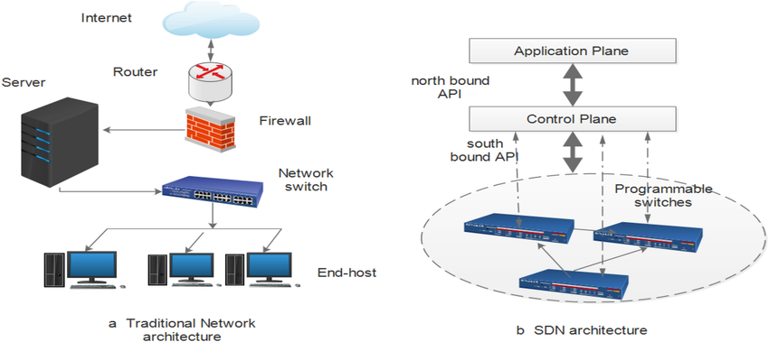
Introduction – Traditional Network Architecture Limitations
The diverse quality of service (QoS) requirements of these use cases highlight the limitations of traditional network architectures, which cannot efficiently support the varying demands of different vertical services.

Slide 10
Introduction – Traditional Network Architecture Limitations
Manual Configuration:
Traditional networks rely on manual configuration of individual devices such as routers and switches. This process is time-consuming, increases operational complexity, and is prone to human error, making it difficult to maintain consistency across the network
Limited Scalability:
These architectures struggle to scale effectively with the increasing number of devices and bandwidth demands. They often require significant reconfiguration when new devices are added, which can lead to oversubscription and performance issues

Slide 11
Introduction – Traditional Network Architecture Limitations
Inconsistent Quality of Service (QoS):
Complexity in Management
Implementing consistent QoS policies across numerous devices is challenging due to the manual nature of configurations. This inconsistency can lead to inadequate performance for applications requiring high reliability and low latency, such as uRLLC
The complexity of managing traditional networks increases with the number of protocols and devices involved. This complexity makes it difficult to troubleshoot issues that affect multiple devices, leading to longer resolution times and increased downtime

Slide 12
Introduction – Traditional Network Architecture Limitations
Rigid Architecture:
Vendor Dependence:
Many traditional networks are built on proprietary hardware and software solutions, which can limit flexibility and increase costs when integrating new technologies or scaling services
Traditional networks have a hierarchical architecture that is not easily adaptable to changing business needs or traffic patterns. This rigidity prevents dynamic resource allocation, which is essential for accommodating varying demands from different applications

Slide 13
Network Slicing - as a Solution
A promising approach to address these challenges is network slicing, which partitions a physical network into multiple isolated logical networks.
This concept mirrors server virtualization in cloud computing, allowing for dynamic resource allocation based on specific application needs.

Slide 14
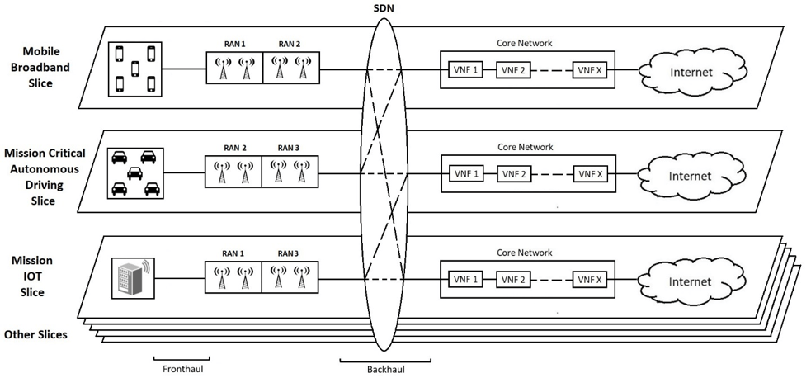
Network Slicing - as a Solution
Network slicing enables the creation of tailored virtual networks that can adapt to the unique requirements of different services, effectively providing a network-as-a-service (NaaS) model

Slide 15
Network Slicing - Benefits
Cost Efficiency
Flexibility
Operators can quickly deploy and manage network slices tailored to specific customer needs.
Scalability
Easily scales resources up or down based on demand, accommodating varying service requirements
Reduces the need for dedicated physical infrastructure by allowing multiple services to share the same resources

Slide 16
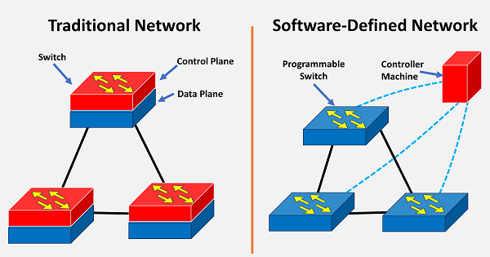
Role of SDN and NFV in Network Slicing
Software-Defined Networking (SDN) and Network Function Virtualization (NFV)/Network virtualized function (NVF) are foundational technologies that enhance network slicing capabilities:
SDN separates control and data planes, providing centralized management and improved visibility across the network.
NFV shifts network functions from hardware to software applications on general-purpose hardware, increasing elasticity and reducing costs

Slide 17
Network Slicing in 5G
Network slicing in 5G refers to the creation of multiple virtual networks on top of a single physical network.
Each slice operates independently with its own resources, topology, traffic flow, management policies, and protocols, allowing for tailored connectivity for specific applications or services

Slide 18
Network Slicing in 5G
The primary goal of network slicing is to meet the unique requirements of various use cases—ranging from enhanced mobile broadband (eMBB) for high-bandwidth applications to ultra-reliable low-latency communication (uRLLC) for critical services like remote surgery

Slide 19
Network Slicing in 5G - Challenges
Resource Provisioning
Mobility Management
End-to-End Orchestration
Managing resource allocation among multiple slices is complex due to varying resource affinities that can change over time
Handling mobility across slices can complicate the management of resources and connectivity
Coordinating the orchestration and management of slices across different domains (like RAN and core networks) adds complexity to implementation

Slide 20
Network Slicing in 5G – Generic Framework
Infrastructure Layer: This layer includes the physical resources such as servers, storage, and networking equipment.
Network Function Layer: This layer encompasses the virtualized network functions that can be deployed within each slice.
Service Layer: This layer focuses on the specific services offered to end-users through the various slices

Slide 21
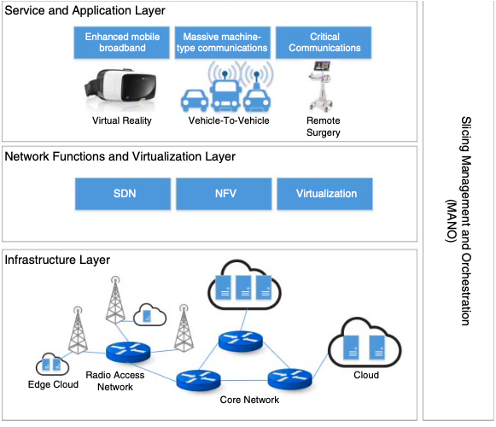
Network Slicing in 5G – Generic Framework

Slide 22
Network Slicing in 5G – Generic Framework

Slide 23
Network Slicing in 5G – Generic Framework
Infrastructure Layer
It defines the actual physical network topology that supports multiple virtual networks.
Physical Network Architecture: The infrastructure layer extends from edge cloud environments to remote cloud setups, encompassing both the radio access network (RAN) and the core network. This layered approach allows for efficient resource allocation and management across various network components .

Slide 24
Network Slicing in 5G – Generic Framework
Infrastructure Layer
Resource Abstraction: Utilizing software-defined techniques, this layer facilitates resource abstraction, allowing for dynamic allocation of compute, storage, bandwidth, and other resources to different network slices. This abstraction is critical for enabling flexibility and responsiveness to varying service demands .

Slide 25
Network Slicing in 5G – Generic Framework
Infrastructure Layer
Policy Implementation: Within the infrastructure layer, various policies are established to deploy, control, manage, and orchestrate the underlying physical infrastructure. These policies ensure that resources are allocated effectively to meet the specific needs of each slice while maintaining overall network performance .
End-to-End Resource Allocation: The infrastructure layer plays a crucial role in allocating resources to network slices in a manner that supports upper layers. This allocation is done contextually, ensuring that each slice can operate independently with the necessary resources to fulfill its requirements

Slide 26
Network Slicing in 5G – Generic Framework
Network Function and Virtualization Layer
The Network Function and Virtualization Layer operates above the infrastructure layer and is responsible for managing the lifecycle of virtual resources and network functions
Lifecycle Management: This layer executes all necessary operations for managing virtualized network functions (VNFs), ensuring optimal placement of these functions within the available physical resources.

Slide 27
Network Slicing in 5G – Generic Framework
Network Function and Virtualization Layer
Chaining of Slices: It facilitates the chaining of multiple slices to meet specific service requirements. By coordinating how different slices interact, this layer ensures that applications can leverage combined functionalities across slices .
Technical Aspects: Key technologies such as Software-Defined Networking (SDN) and Network Function Virtualization (NFV) are integral to this layer. They enable efficient management of both coarse-grained and fine-grained network functions across the core and local RAN .

Slide 28
Network Slicing in 5G – Generic Framework
Service and Application Layer
The Service and Application Layer represents the topmost layer where various applications and services operate:
Use Cases: This layer includes connected devices such as vehicles, IoT devices, mobile phones, and VR appliances. Each application or service has specific utility expectations from the underlying networking infrastructure.
Mapping Functions: Based on high-level service requirements, virtualized network functions are mapped to physical resources to ensure compliance with Service Level Agreements (SLAs). This mapping ensures that each application receives the necessary resources without violating performance guarantees .

Slide 29
Network Slicing in 5G – Generic Framework
Slicing Management and Orchestration (MANO) in 5G
This layer oversees the functionality of the underlying infrastructure, network functions, and service layers by performing three main tasks:
Creation of Virtual Network Instances: The MANO layer is responsible for creating virtual network instances based on the physical network resources defined in the infrastructure layer. This process allows for the establishment of independent slices that can cater to various applications and services.

Slide 30
Network Slicing in 5G – Generic Framework
Slicing Management and Orchestration (MANO) in 5G
Mapping Network Functions: It maps network functions to these virtualized network instances, facilitating the construction of service chains. This mapping is essential for ensuring that specific service requirements are met through the appropriate allocation of resources and functionalities from the network function and virtualization layer.

Slide 31
Network Slicing in 5G – Generic Framework
Slicing Management and Orchestration (MANO) in 5G
Lifecycle Management: The MANO layer maintains communication between the service/application layer and the network slicing framework. This function involves managing the lifecycle of virtual network instances and dynamically adapting or scaling virtualized resources in response to changing contexts or demands

Slide 32
Network Slicing in 5G – Generic Framework
Characteristics of Cloud-Native Network Architecture for 5G
Cloud Data Center-Based Architecture:
It provides a logically independent network slicing capability over a cloud data center infrastructure, supporting various application scenarios.
Cloud-RAN Implementation:
The architecture employs Cloud-RAN to build radio access networks (RAN), facilitating many connections and enabling on-demand deployments of RAN functions as required by 5G.
Simplified Core Network Architecture:
The core network design is streamlined, allowing for on-demand configuration of network functions through user and control plane separation, unified database management, and component-based functionalities.
Automated Network Slicing Services:
The architecture implements network slicing services automatically to reduce operational expenses, enhancing efficiency in resource utilization .

